Slide 1

The National University of Computer and Emerging Sciences
Programming Fundamentals
CS 1002 Programming Fundamentals
Dr. Akhtar Jamil
Department of Computer Science

Slide 2
Goals
Review of Previous Lecture
What is a Computer?
Programming Languages
Introduction to Pseudocode
Flowcharts

Slide 3
What to do for being Successful?
Be punctual
Do not put off your today work till tomorrow.
Start on the given task as soon as it is given.
Set your goals, for each day, week and month.
Be attentive and proactive in the class.
Communicate your problems and discuss them immediately. Don’t be Shy and ask questions.
Think big and do not limit yourself to the class content, explore and imagine.

Slide 4
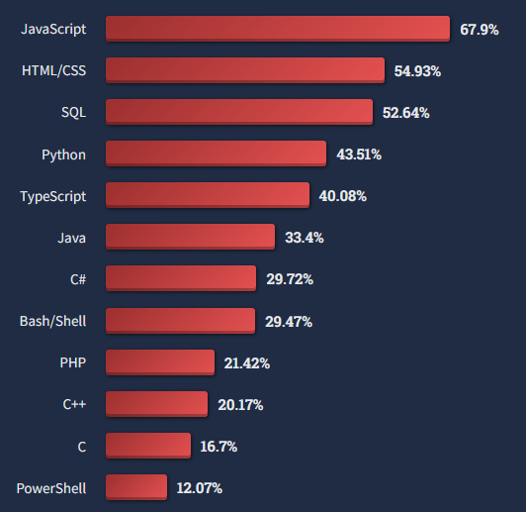
Popular Technologies: Stackoverflow

Slide 5
Fact Check
IT service exports from India were estimated at about 149.1 billion U.S. billion dollars in the fiscal year 2021 (statista.com).
Pakistan’s IT exports to surpass $3 billion this year (express tribune.com)
Investments by Pakistani start-ups had grown almost five times as compared to the year 2020

Slide 6
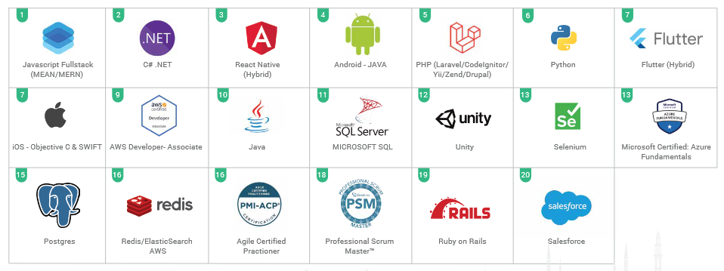
Top in-demand technologies & tools: Pakistan

Slide 7
Live Programming & Visualization Environments
http://www.pythontutor.com/cpp.html#mode=display
https://pythontutor.com/visualize.html#mode=edit
https://www.onlinegdb.com/online_c++_compiler#
https://www.programiz.com/cpp-programming/online-compiler/

Slide 8
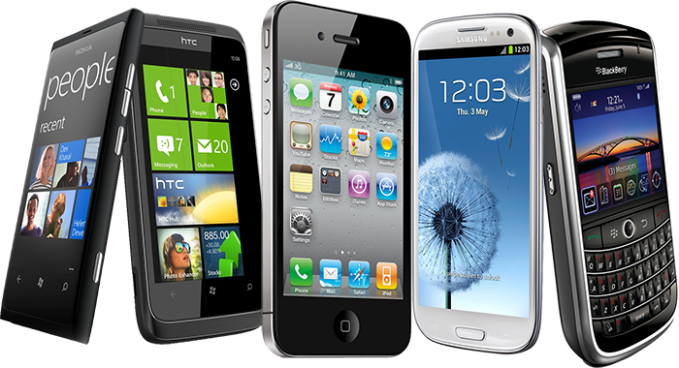
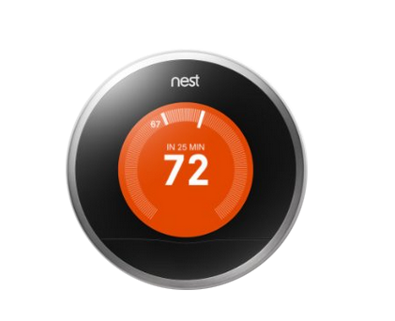
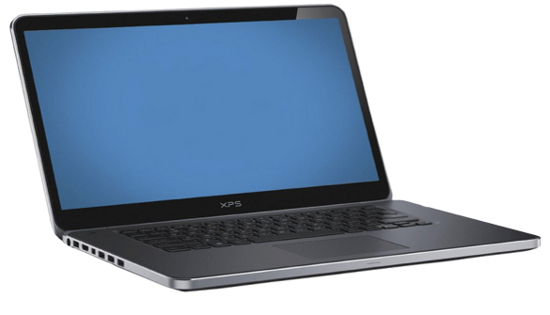
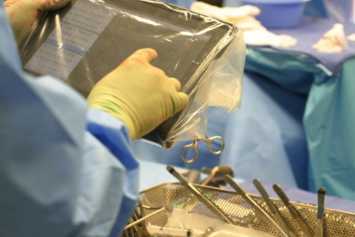
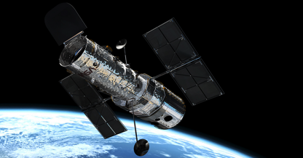

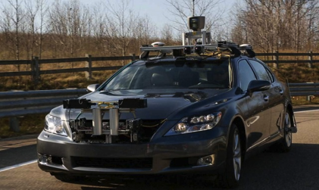

Why Computer Science ?
Computer science is changing everything

Slide 9
What is the most important skill of a Computer Scientist ?
What is the most important skill for a computer scientist?
a) To think like a computer. b) To be able to write code really well. c) To be able to solve problems. d) To be really good at math.

Slide 10
Let us Start

Slide 11
What is a Computer?
A computer is a electronic device that works semi-automatically to process input data according to the stored set of instructions and produces output or resultant data.
Instructions
A Computer System
Results
Data

Slide 12
Components of a Computer System
Peripheral Devices / Connected devices
Keyboard
Mouse
Display
CD Rom
Hard Disk
Computer
Main Memory
CPU
A Typical
Von-Nueman Machine
Arithmetic and Logic Unit
Control Unit

Slide 13
Computer Instructions and Programs
Instruction: A computer instruction is a command or directive given to a computer to perform specific task.
Examples: Add 2 and 5, Print “Hello World”
Program: A program is sequence of instructions written in programming language that directs a computer to solve a problem
Examples: Draw a square, etc.

Slide 14
Computer Instructions and Programs
Program: “Draw a square”
1 – Draw a vertical line of length n inches
2 – Draw a horizontal line of n inches
3– Draw a vertical line of length n inches
4 – Draw a horizontal line of n inches

Slide 15
Computer Software System
Application Programs
(.cpp, .c, .java,)
Compilers / Libraries
(C++, C, Java)
Operating Systems
(Windows, Linux, MAC, Solaris)
Computer Hardware

Slide 16
Programming Languages
Classification of programming languages:
Machine language
Low-level languages
High-level languages

Slide 17
1. Machine level languages
A computer understands only sequence of bits or 1’s and 0’s (the smallest piece of information)
A computer program can be written using machine languages (01001101010010010….)
Very fast execution
Very difficult to write and debug programs
Machine specific (different codes on different machines)

Slide 18
2. Low level languages
English encrypted words instead of codes
More understandable (for humans)
Example: Assembly language
Requires: “Translation” from Assembly code to machine code
Assembly Code
Machine Code
Assembler
compare:
cmpl #oxa,n
cgt end_of_loop
acddl #0x1,n
end_of_loop:
1001010101001101
1110010110010100
0101010111010010
0110100110111011
1101100101010101

Slide 19
3. High level languages
Mostly machine independent
Close to natural language (English like keywords)
Easy to write and understand programs
Easy to debug and maintain code
Requires compilers to translate to machine code
Slower than low-level languages

Slide 20
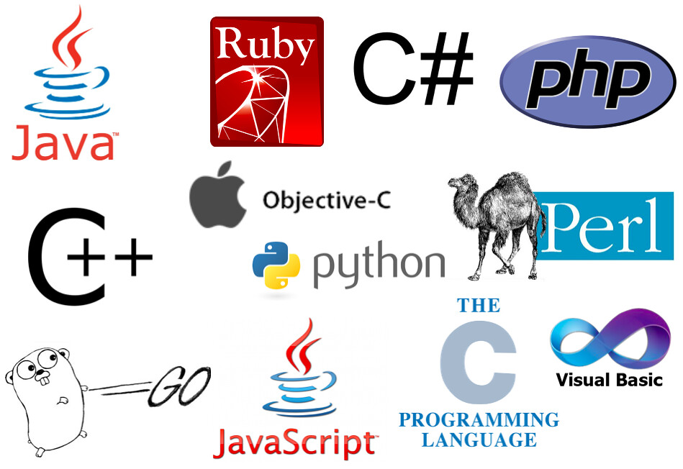
3. High level languages
Many popular High-Level languages
https://c1.staticflickr.com/4/3912/15090961835_c4f26e4890_b.jpg

Slide 21
Programming Paradigms
Programming paradigm is the fundamental style of computer programming:
Imperative
Functional
Logical
Object Oriented

Slide 22
Imperative Paradigm
Sequence of steps required to compute
Statements executed sequentially step-wise
Emphasis on “How is to compute” or, “How to obtain” the required results or output
Example languages: C, Pascal, etc.

Slide 23
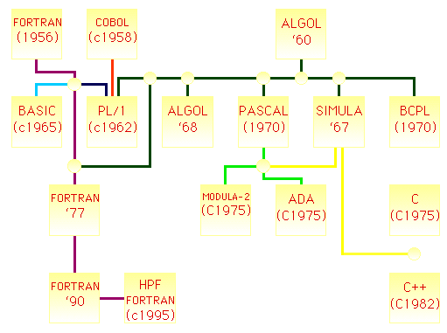
Imperative Paradigm Languages

Slide 24
Functional/Logical Paradigm
Responsibility of a programmer is to specify What is to compute
How to compute is implementation dependent and is managed by language compiler
Example languages: Lisp , Erlang, Scala, etc.

Slide 25
Object-Oriented Paradigm
Programming with Abstract Data Types, to model real world
Basic Program Unit: Class (a programmer defined type)
A entity that contains data and methods which work on the data
Basic Run-time Unit: Object
Instance of a class during execution

Slide 26
Problem Solving Steps
Understand the problem
Plan the logic
Code the program
Test the program
Deploy the program into production

Slide 27
1. Understanding the Problem
Problems are often described in natural language like English.
Identify the requirements
Inputs or given data-items
Required output(s) or desired results
Indirect inputs (may not be given directly, you have to calculate or assume)

Slide 28
1. Understanding the Problem
Example: Calculate the area of a circle having the radius of 3 cm
Inputs:
Radius=3
Output:
Area
Indirect Inputs:
Pi=3.14
Area = 3.14 * (3*3) = 28.27

Slide 29
2. Plan the Logic
Identify/Outline small steps in sequence, to achieve the goal (or desired results)
Tools such as flowcharts and pseudocode can be used:
Flowchart: a pictorial representation of the logic steps
Pseudocode: English-like representation of the logic
Advice: Walk through the logic before coding

Slide 30
3. Code the Program
Code the program:
Select the programming language
Write the program instructions in the selected programming language
Use the compiler software to translate the program into machine understandable code
Syntax errors (Error in program instructions) are identified by the compiler during compilation and can be corrected.

Slide 31
4. Test the Program
Testing the program
Execute using sample data and check the results
Identify logic errors if any (undesired results or output) and correct them

Slide 32
5. Deploy the Program
Putting the program into production
Do this after testing is complete and all known errors have been corrected

Slide 33
Practice Task
You are required to take a number as input from user and find if this number is prime or not. Try to understand the problem, its inputs and outputs.
How you will solve this problem?
Identify the steps that should be performed.

Slide 34
References
Credit goes to Dr. Muhammad Aleem for preparation of slides

Slide 35
Thank You ☺

